Slide 1


Slide 2



INTRO
We are Tjekvik
Hi, I am Kuba
Hi, I am Michał
Team Lead & Full Stack Developer
Technical Team Lead & Integrations Specialist

Slide 3
Agenda
1
Tjekvik introduction
4
Scheduling jobs
Brief Intro about Tjekvik
?
2
What’s here for me
5
Monitoring import status
If I don’t work in Automotive?
Q&A
3
Importing data on example
6
Key take-aways

Slide 4
Tjekvik?

Slide 5
Tech stack
Ruby on Rails
React
Service kind of architecture (5 apps + gems & JS libraries)
Hosted on Heroku

Slide 6

What problem do we solve?

Slide 7
Flow Timeline
Call the
Dealer
Enter data
Into DMS
Tjekvik imports
Data

Slide 8
What’s special about our product?
Integration with Dealer’s favourite DMS
✔
No need to change Dealer’s
existing processes
✔

Slide 9
Can I use it for no-cars?

Slide 10

Can I use it for no-cars?
Any project that relies on importing data from external parties
E-commerce marketplaces showing products from multiple stores
Search engines
Audience? Any other examples?

Slide 11
Importing things

Slide 12
What we deal with?
Importing Data from more than 50 providers
✔
Handling different sources:
REST APIs
SOAP APIs
CSV Files
✔
Various importing schedule criteria
Daily
Every X time
On demand from web interface
✔

Slide 13
Example: Import from 3 sources
01
03
BMW
Volvo
Import data every day at 16:30
Delivers data via REST API
Import data on demand
Import data when it is requested by provider
Delivers data as CSV file
02
PSA
Imports run on hourly basis
Delivers data via SOAP API
Import data on demand
!
NOTE:
We don't integrate with brand itself but with DMS provider

Slide 14


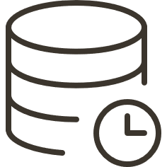
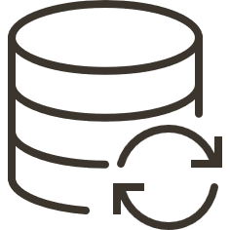
Example: API import flow
Run Worker
at XX:YY
Create import record in DB
Fetch appointment data
Update import record in DB

Slide 15



Example: CSV import flow
Tjekvik
Imports data
Shop Uploads CSV to Server
Webhook to
notify us
Trigger sidekiq worker

Slide 16
Scheduling imports

Slide 17
Example: Import from 3 sources
01
03
BMW
Volvo
Import data every day at 16:30
Delivers data via REST API
Import data on demand
Import data when it is requested by provider
Delivers data as CSV file
02
PSA
Imports run on hourly basis
Delivers data via SOAP API
Import data on demand
!
NOTE:
We don't integrate with brand itself but with DMS provider

Slide 18
Heroku Scheduler
FREE Heroku addon
Runs jobs in one-off dynos

Slide 19
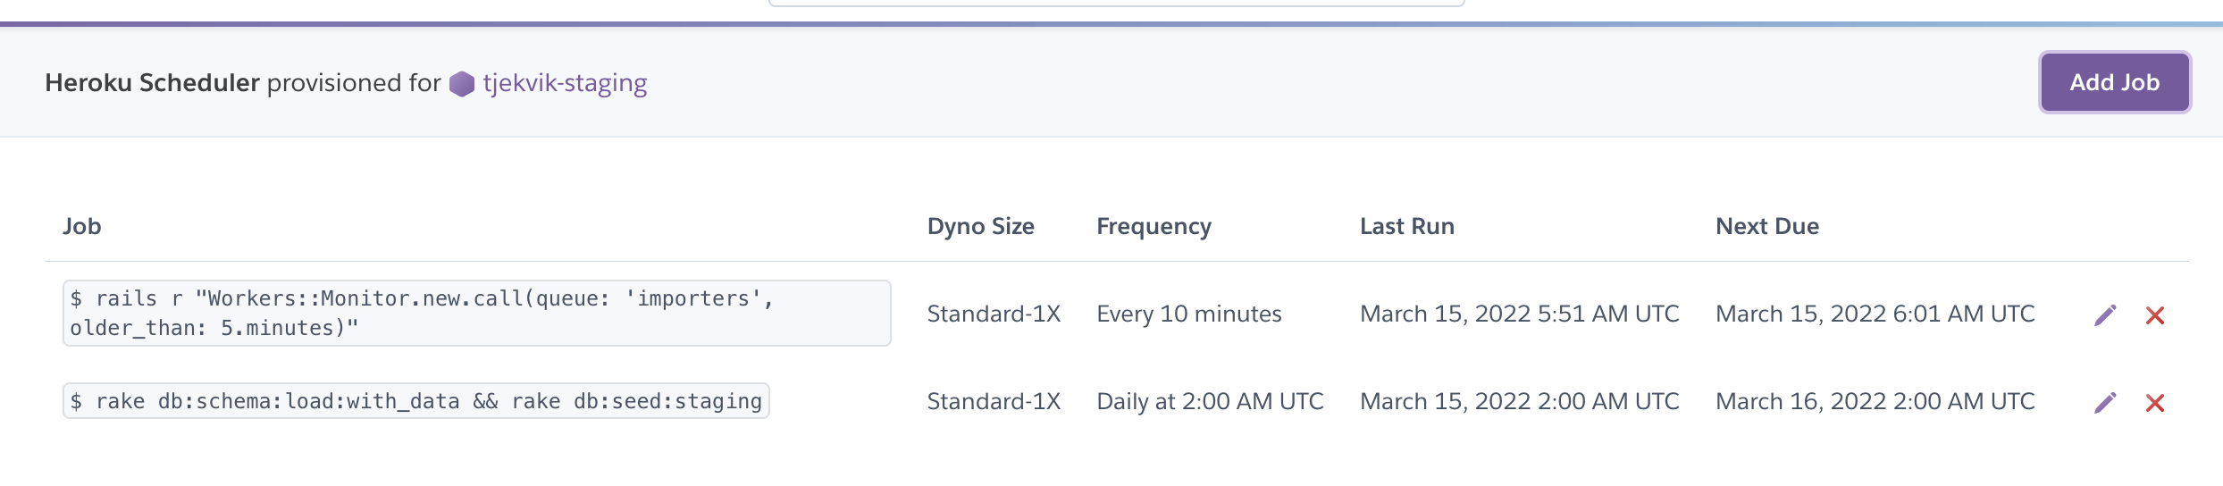
Heroku Scheduler

Slide 20
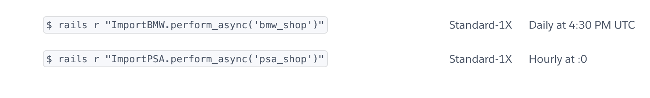
Heroku Scheduler

Slide 21
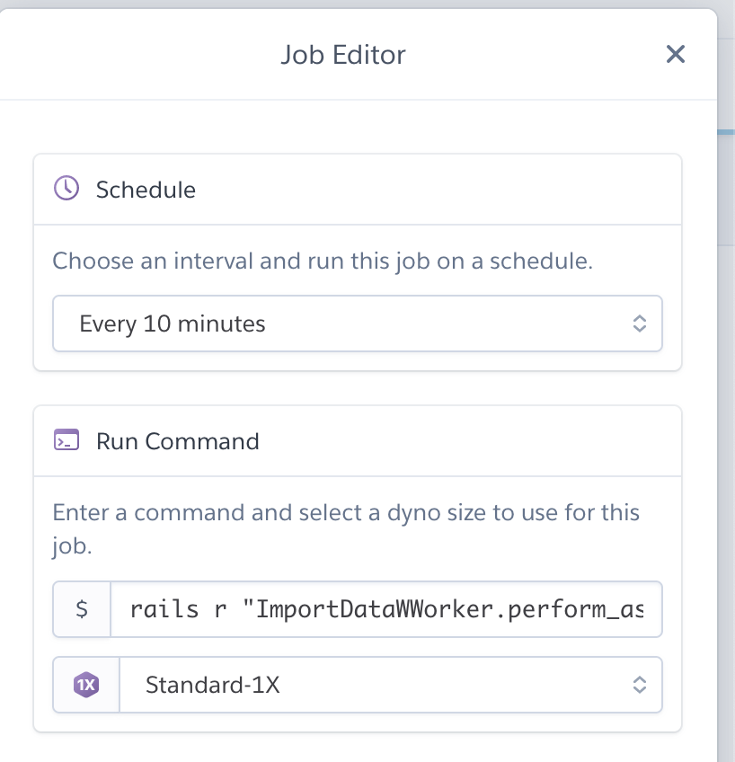
Heroku Scheduler

Slide 22

Heroku Scheduler
It worked fine, until we started missing jobs...

Slide 23
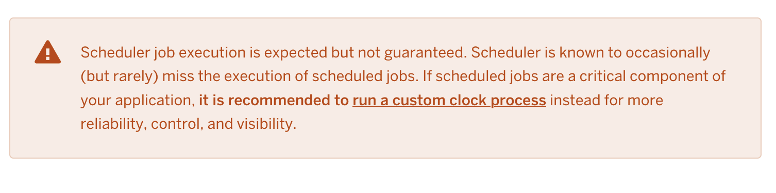
Heroku Scheduler

Slide 24
Heroku Scheduler
Occasionally (but rarely) = every other day
...critical component of your application…

Slide 25
System crontab
It's already there in Linux systems
No access to crontab on Heroku
Can be managed via `whenever` gem

Slide 26
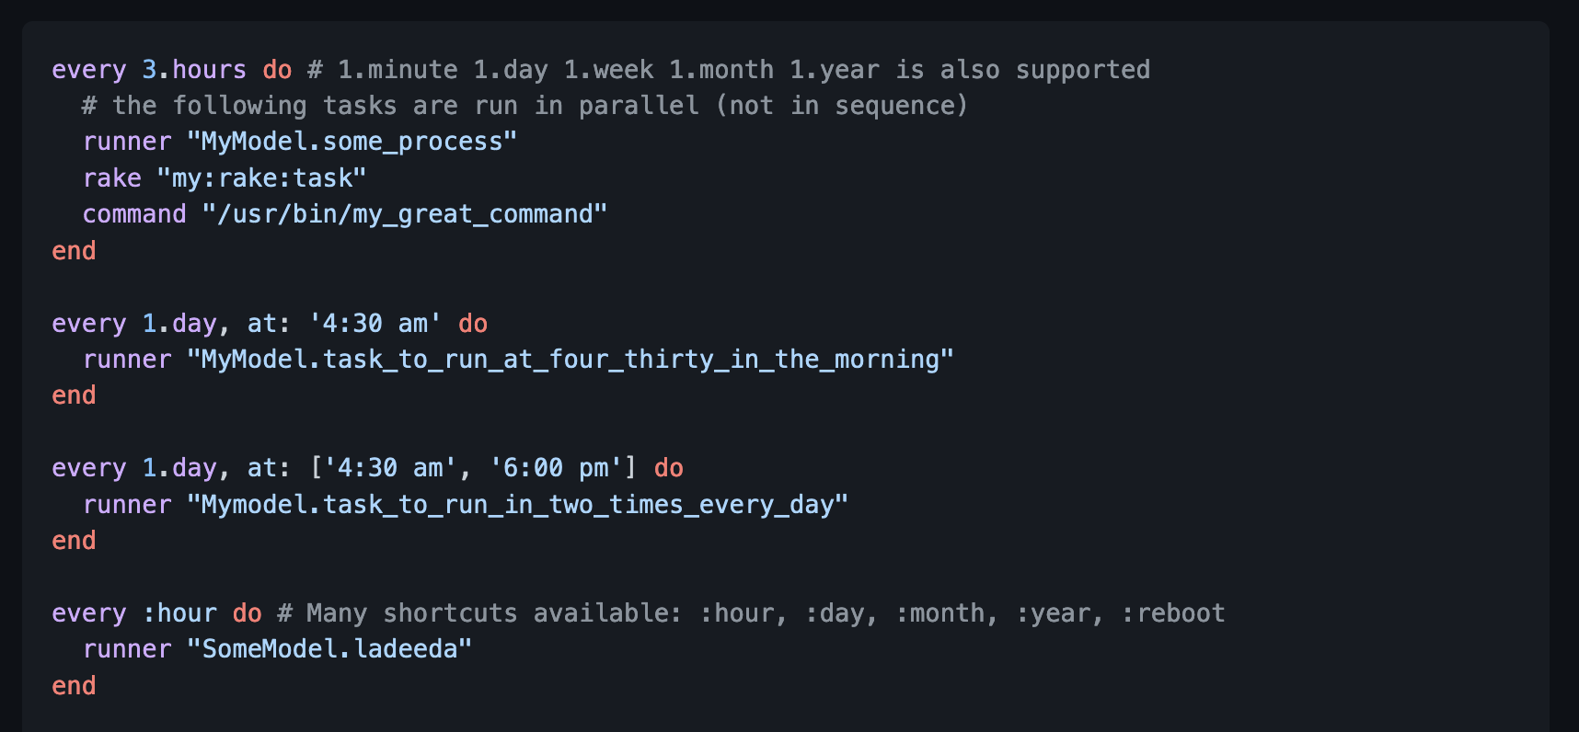
Whenever gem

Slide 27
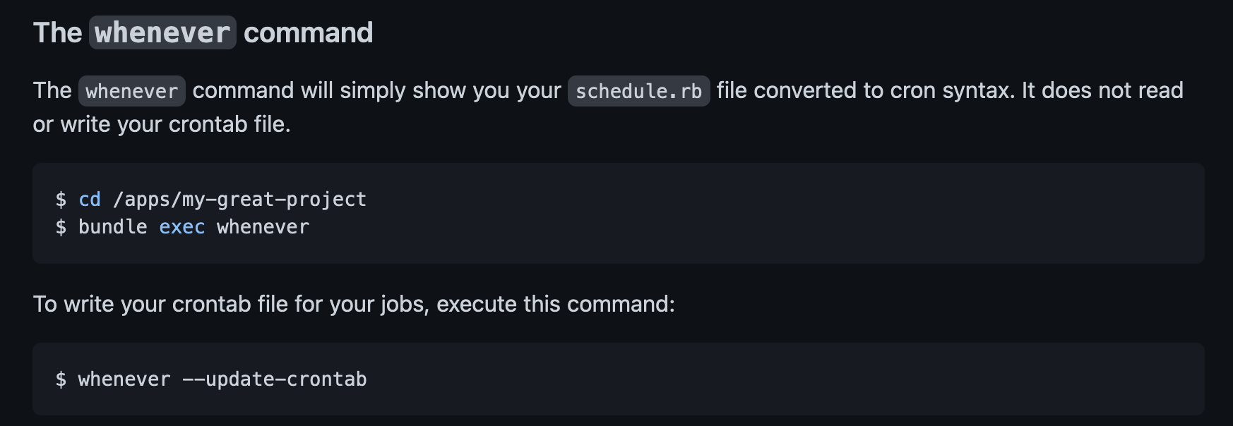
Whenever gem

Slide 28
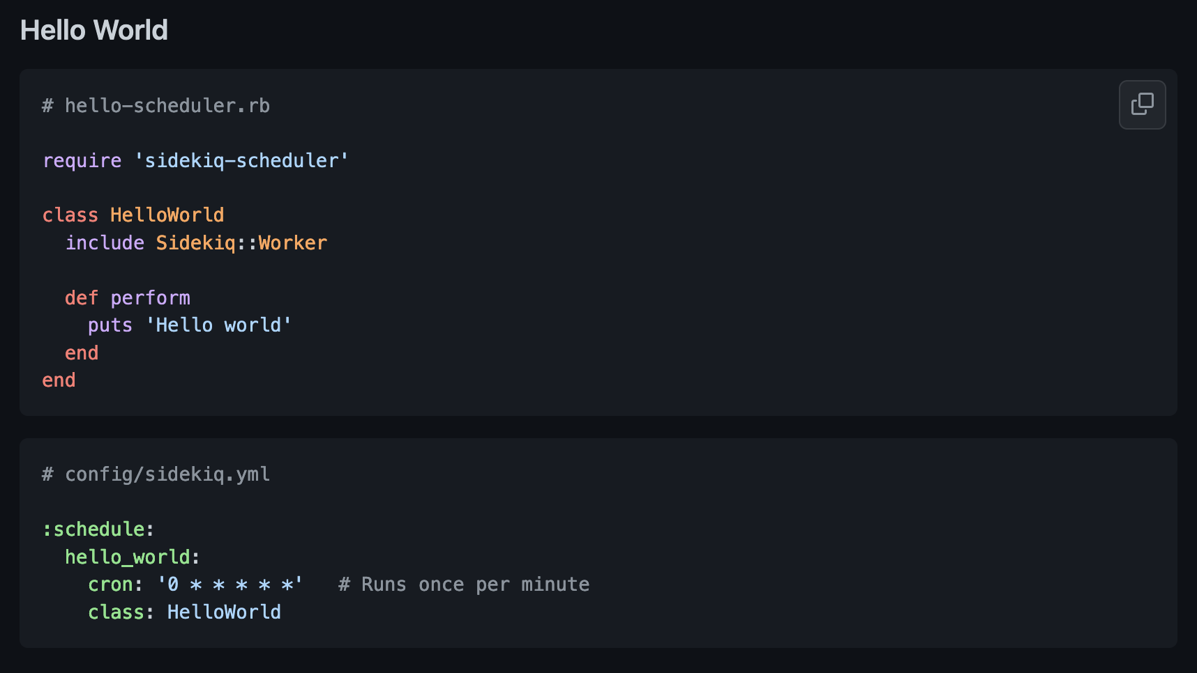
Sidekiq-scheduler

Slide 29
Clockwork gem
Replaces system crontab
Runs as Ruby process
Comes with DSL but can load jobs from the database

Slide 30
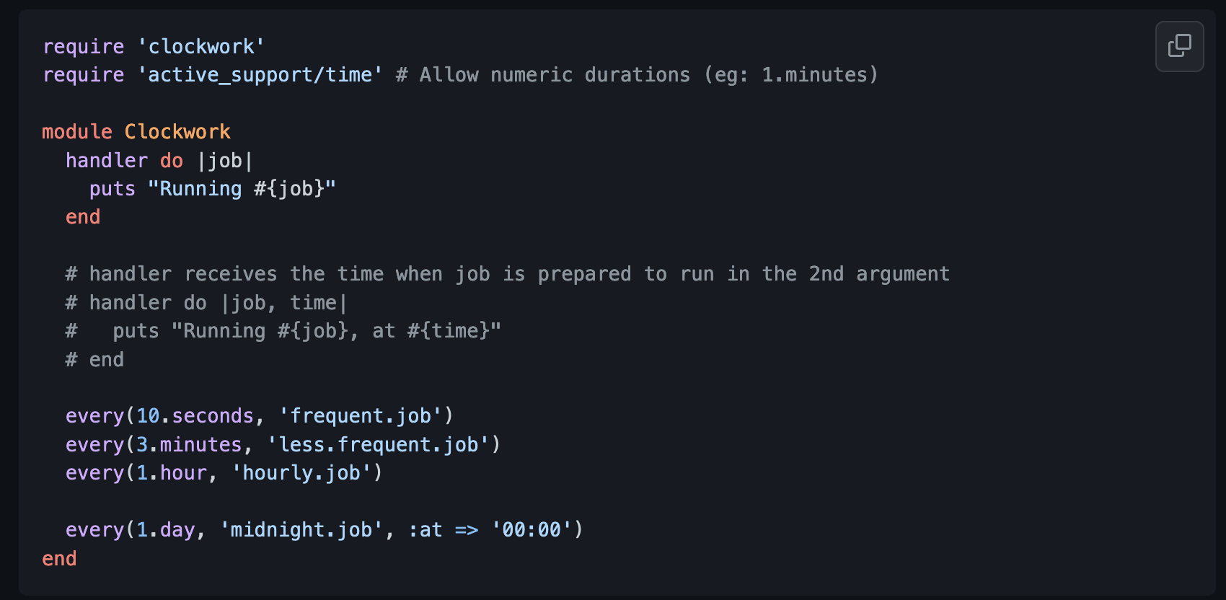
Clockwork gem

Slide 31
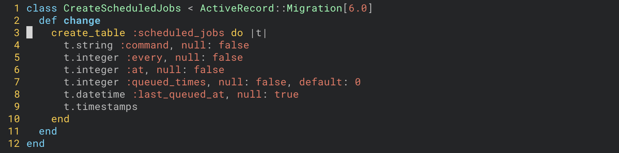
Clockwork gem

Slide 32
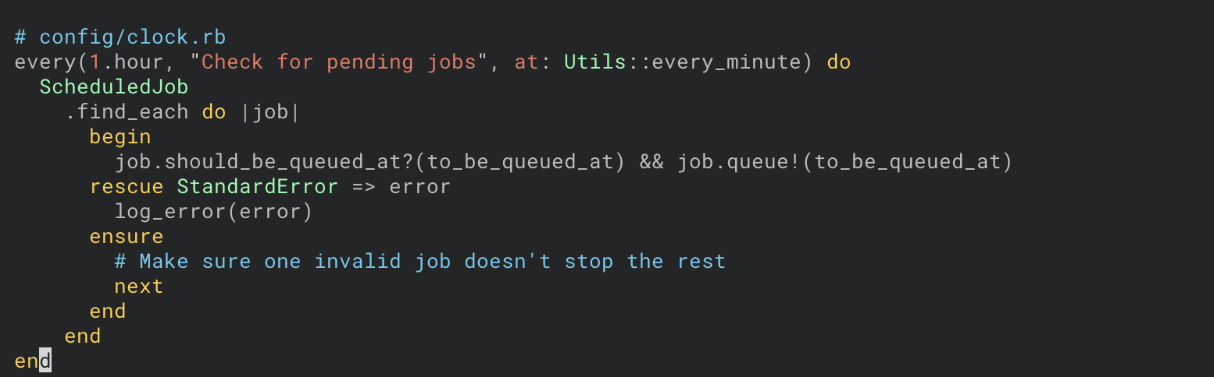
Clockwork gem

Slide 33
Clockwork gem

Slide 34
Monitoring

Slide 35
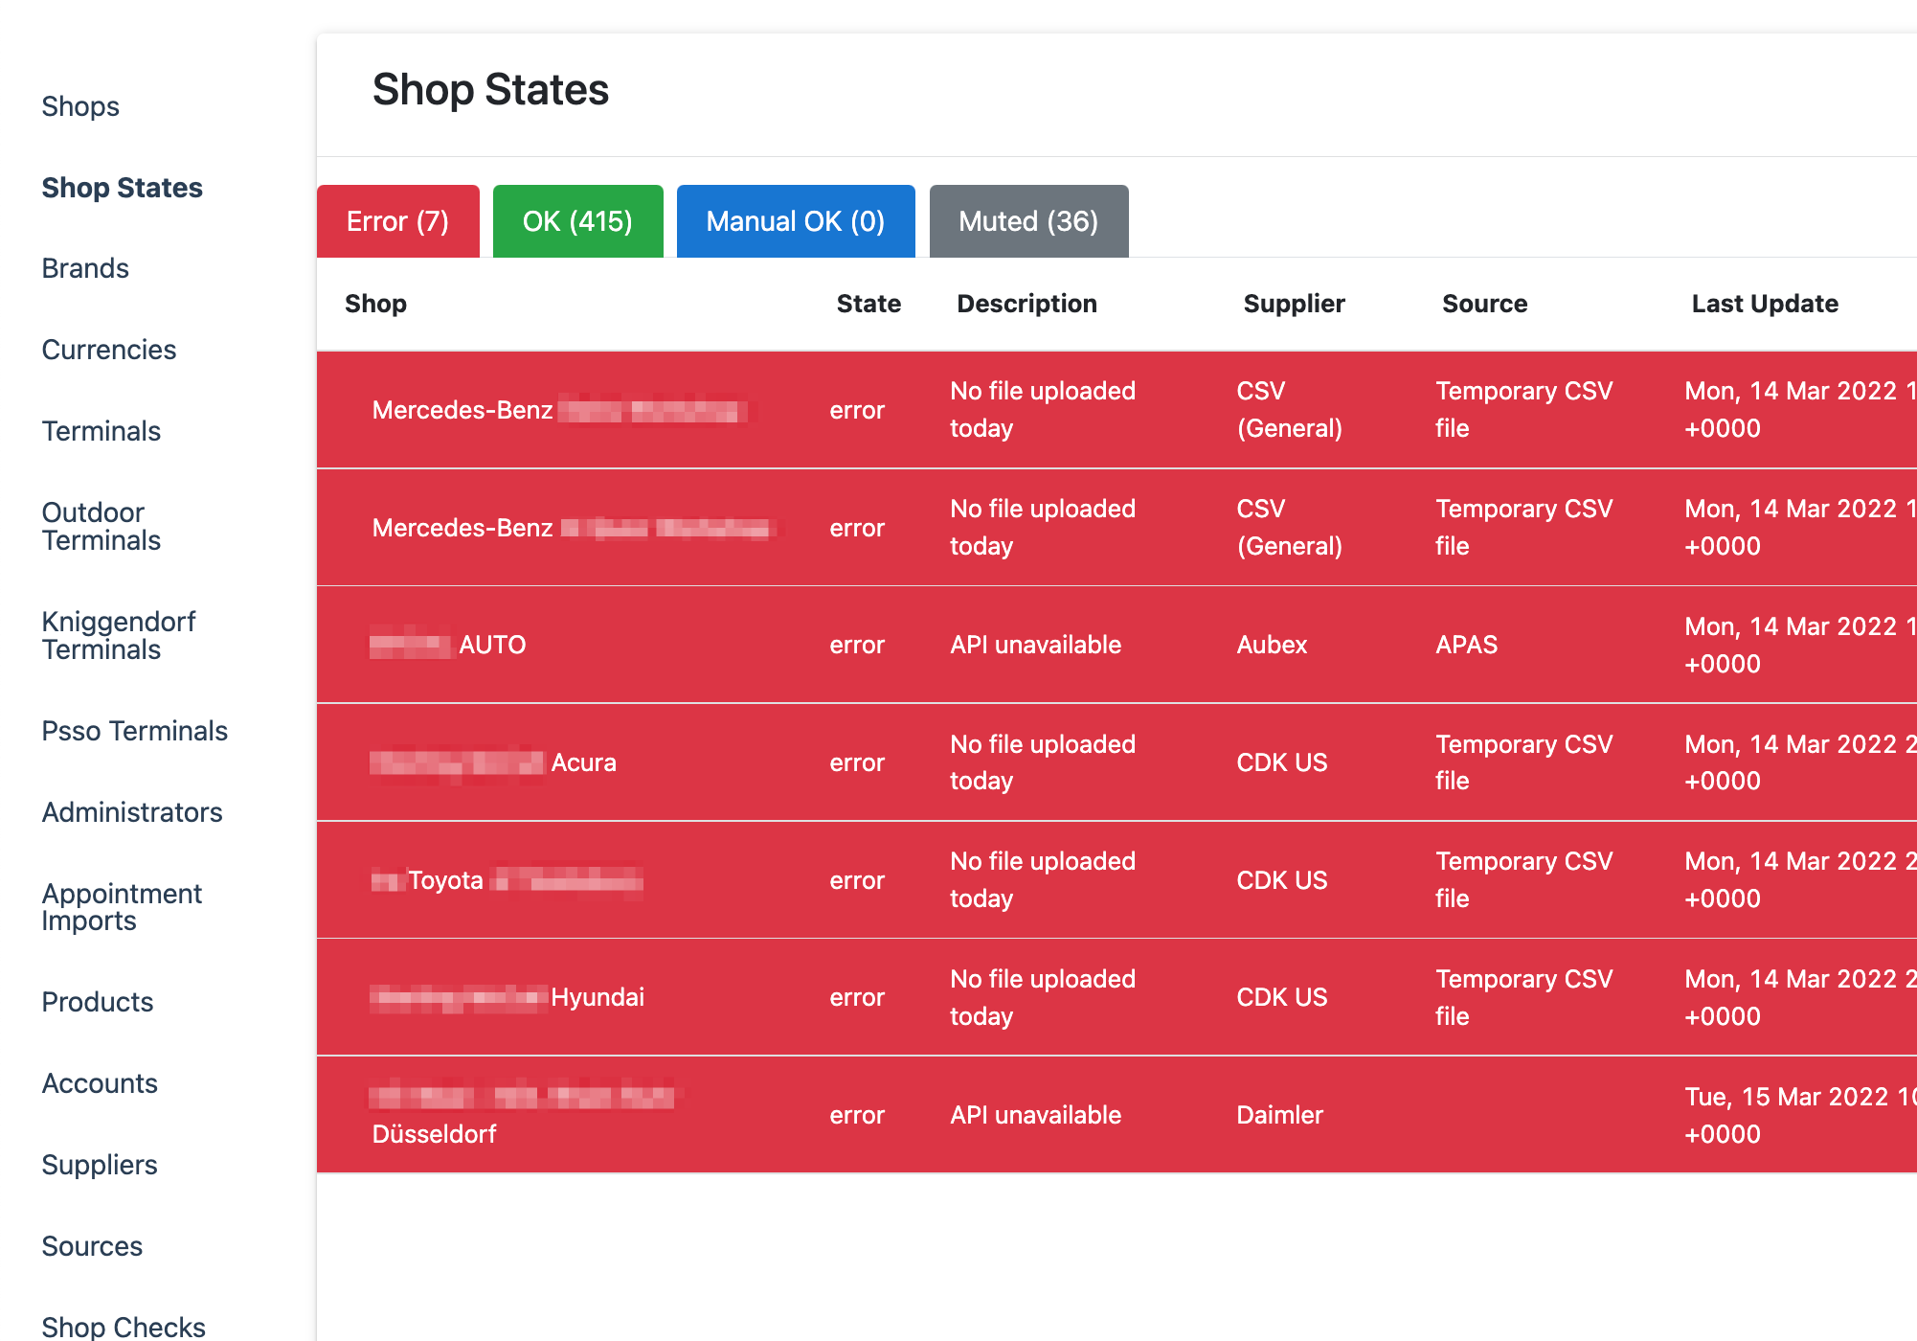
Monitoring & Customer support tools

Slide 36
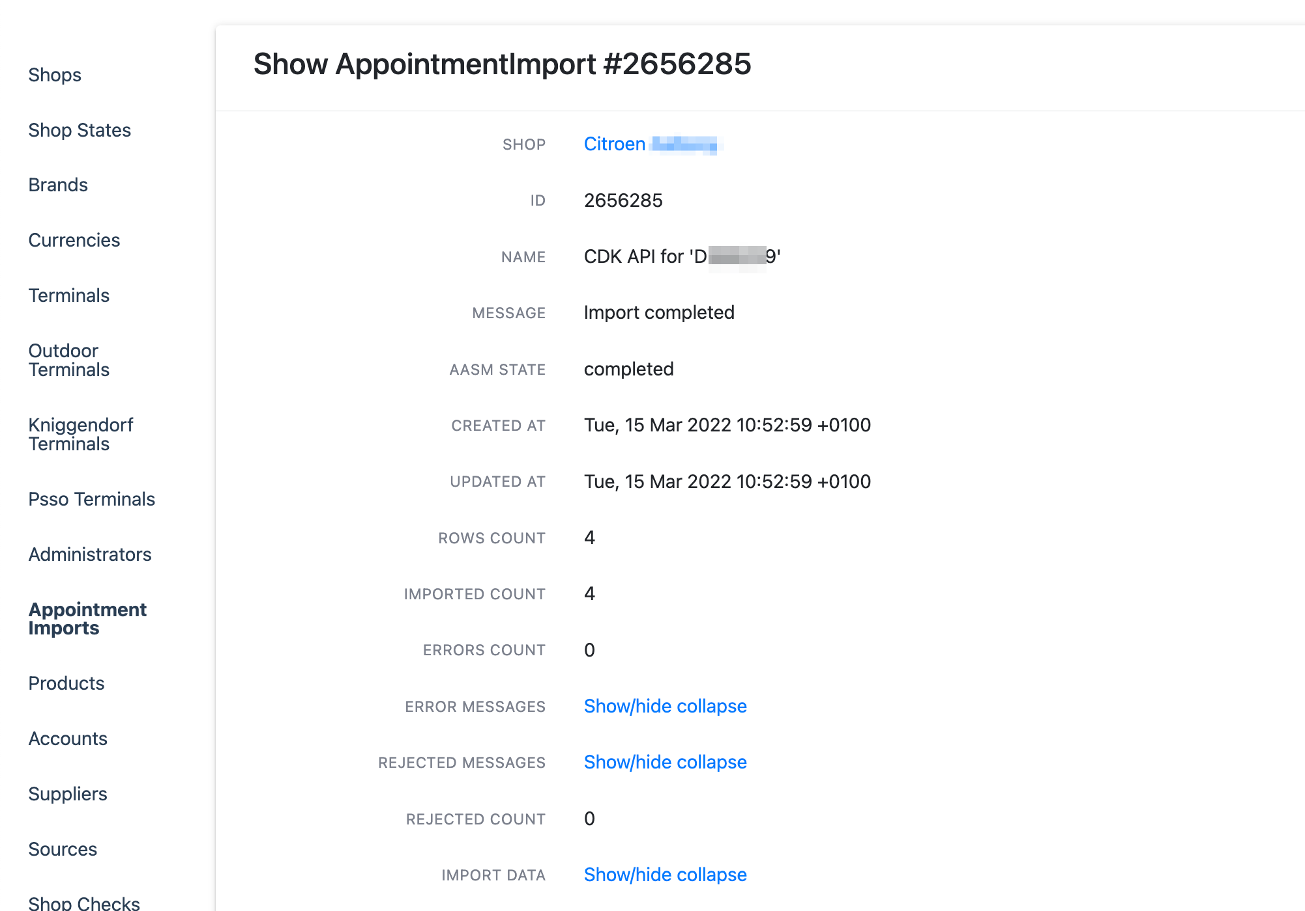
Monitoring & Customer support tools

Slide 37
Let’s wrap it up

Slide 38
Data normalisation is hard

Slide 39
Stay in dialogue with data provider

Slide 40
Embrace failure of external services

Slide 41
Give love to your dev tools & tests

Slide 42
People come and go. Code stays.

Slide 43
We’re hiring

Slide 44
Questions?

